Slide 1


Eventa
A platform to create, manage, and join events with ease.

Slide 2
Introduction
Eventa is a web-based platform designed to simplify the way events are created, managed, and joined. The platform caters to both organizers and participants, allowing event organizers to create and manage events efficiently, while enabling users to discover and join events with ease.
Built on the robust ASP.NET MVC framework,
Eventa provides a scalable and secure solution for modern event management, aiming to enhance user experience and streamline event workflows.

Slide 3

Our Team
Bansee Abdelnasser
Alaa Mahmoud
Responsible for user registration, login, and profile updates, as well as attendee functionalities such as favoriting events and the Organizer Dashboard.
Responsible for event management, categories, and announcements, ensuring organizers can create, edit, and manage events effectively.
Mariam Tarek
Mariam Medhet
Responsible for the ticketing system, booking management, and simulated payments, managing the full flow from ticket creation to attendee booking confirmation.
Built responsive UI/UX in ASP.NET Core MVC ∙ Full authentication ∙ Modular JS ∙ Finalized and polished every page
Mariam Hazem
Created initial version of several pages (Login, Register, Home, etc.) Contributed to the main site.css and early styling

Slide 4

Traditional event management is often manual, time-consuming, and error-prone, making it difficult for organizers to track registrations, manage attendees, and coordinate logistics efficiently.
Participants face challenges in discovering and registering for events, creating a need for a centralized platform that streamlines event creation, management, and participation.
Problem Statement

Slide 5

Implement a structured and maintainable architecture that supports clear workflows for event creation, booking, and ticket management.
Project Goals
Allow attendees to discover events, register, and manage their tickets easily.
Enable organizers to efficiently track participation, and define ticketing options.
Implement role-based access control for organizers, and attendees.

Slide 6
Target Audience
Eventa serves two main groups
Event Organizers
Attendees
Individuals or organizations who need efficient tools to create, manage, and track events.
Users looking to discover, register, and manage participation in events that match their interests.

Slide 7

User Authentication & Roles
Organizer Dashboard
Event Management
Favoriting Events
Website
Features
Announcements & Categories
Ticketing & Booking
Event Discovery & Search
Analytics & Basic Reporting

Slide 8


System Architecture
The system is divided into several layers:
Frontend (MVC): Built with ASP.NET MVC, Razor, HTML, CSS, and Bootstrap for a responsive and user-friendly interface.
API Layer: Acts as an interface between frontend and application layer, exposing endpoints for CRUD operations, event management, and ticketing.
Application Layer: Handles business logic such as event creation, ticketing, and bookings.
Data Access Layer (DAL): Manages database operations for users, events, tickets, bookings, and categories.
Database Layer: SQL Server securely stores all persistent data.
Authentication & Authorization: Implemented with ASP.NET Identity for secure login, registration, and role-based access.

Slide 9


Website Screens Preview

Slide 10
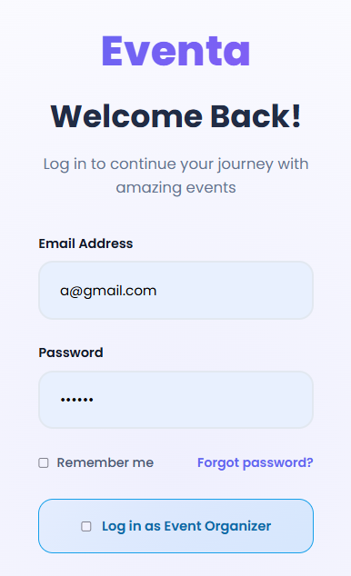
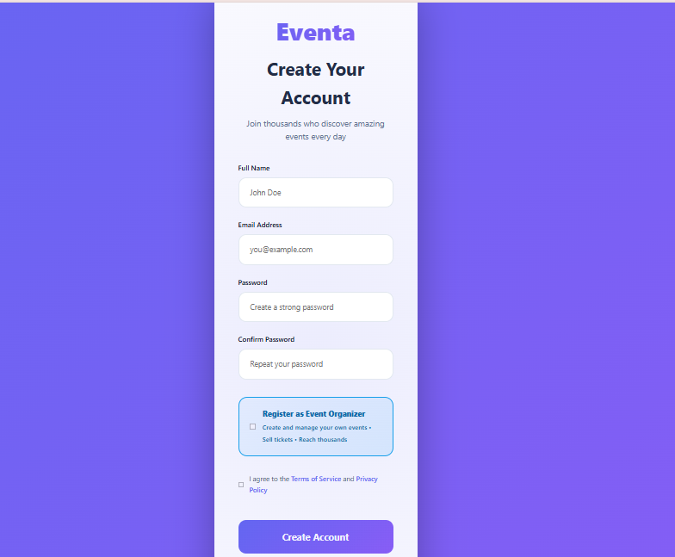
Authentication Screens

Slide 11
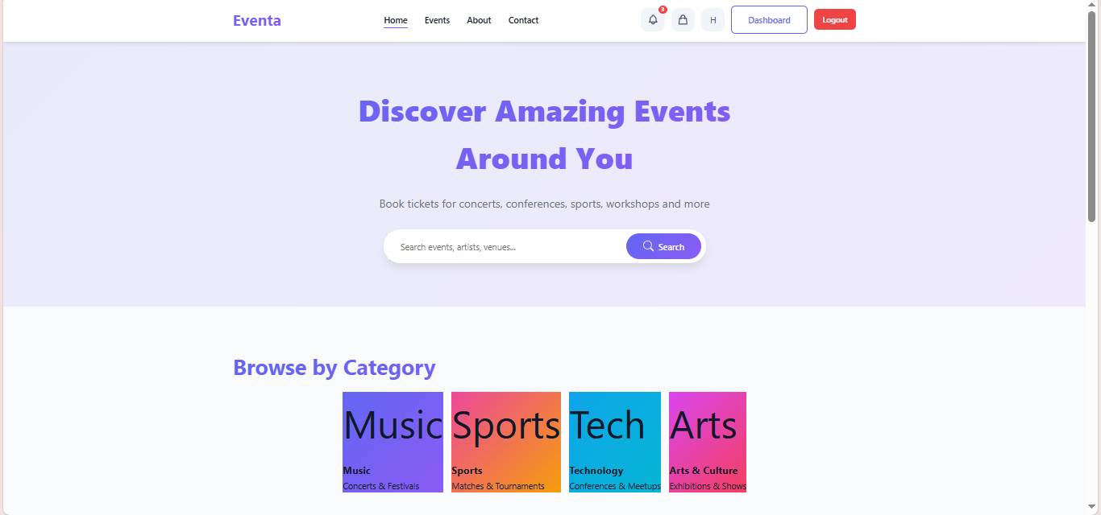
Home screen

Slide 12
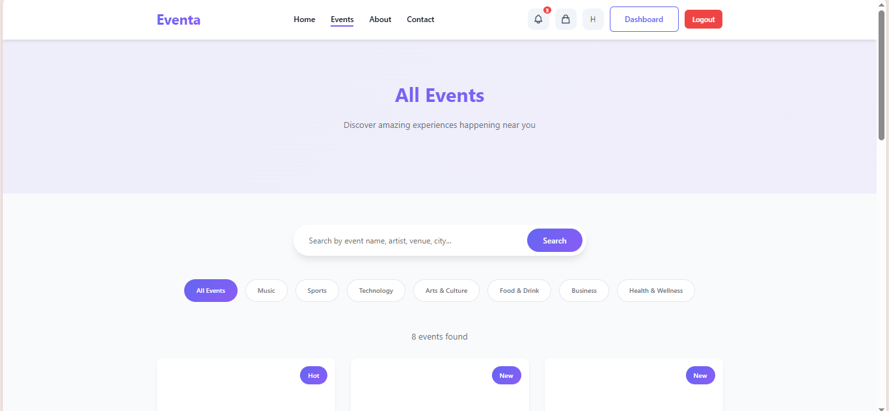
Event Browsing

Slide 13
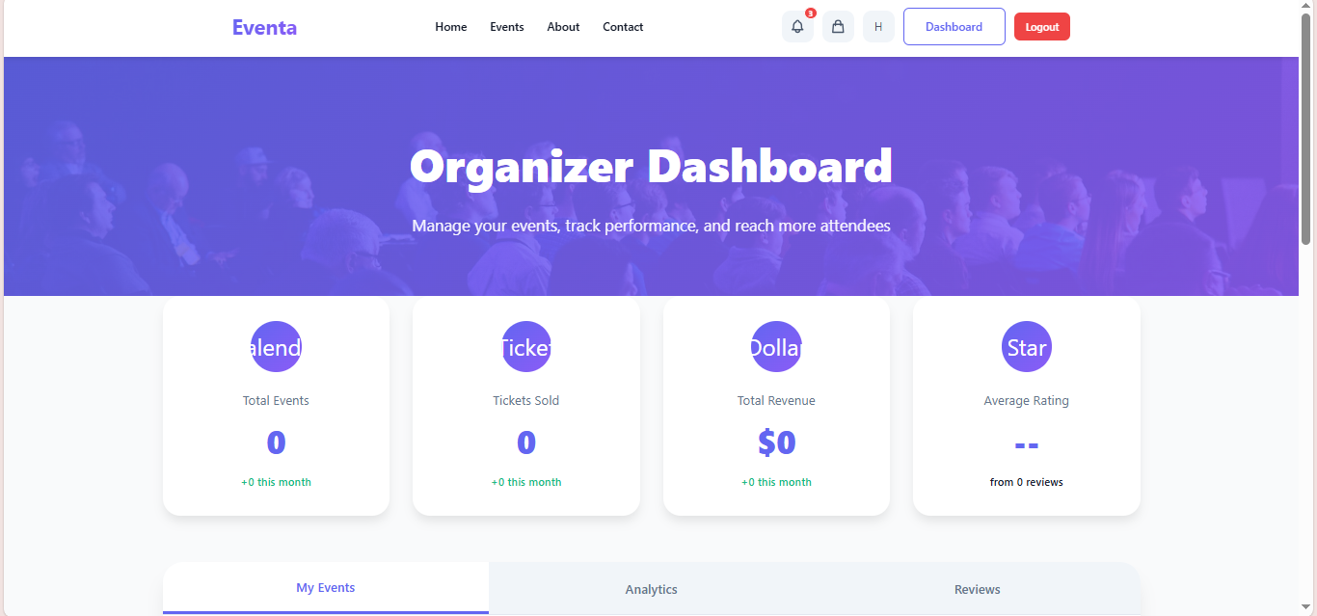
Organizer Experience

Slide 14
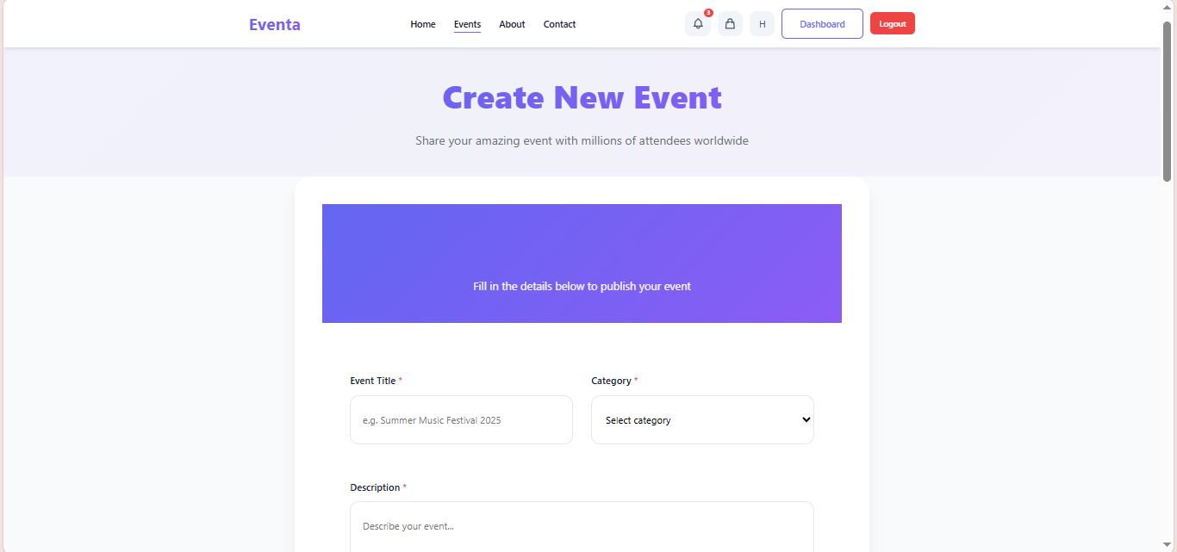

Slide 15

System API Overview

Slide 16
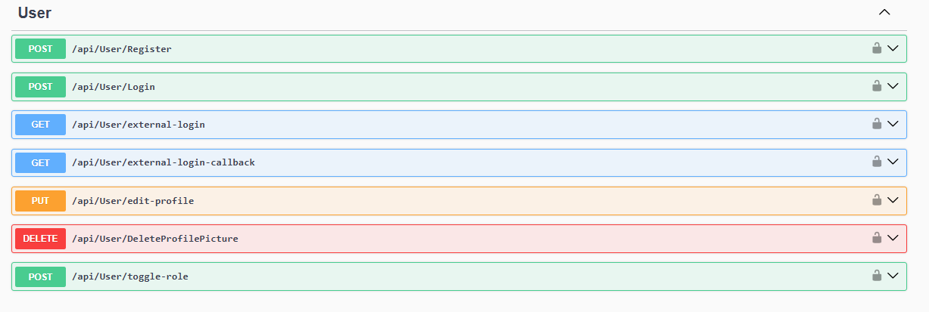
Authentication & Authorization Endpoints
(Attendee → Organizer or Organizer → Attendee )

Slide 17
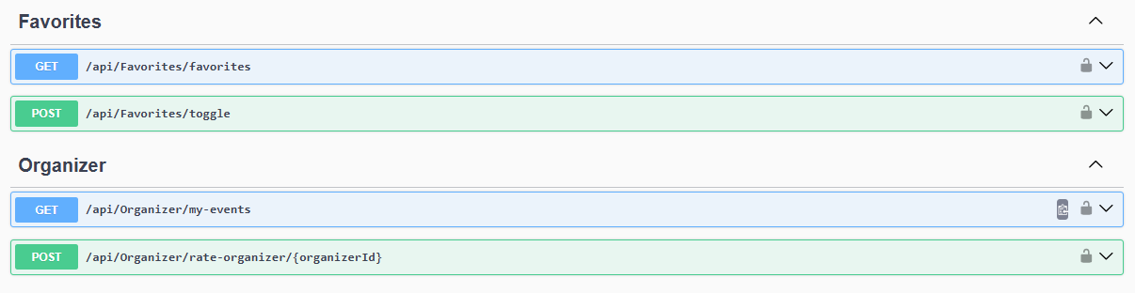
Favorites & Organizer Endpoints

Slide 18
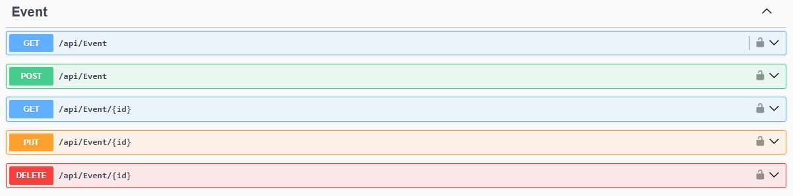
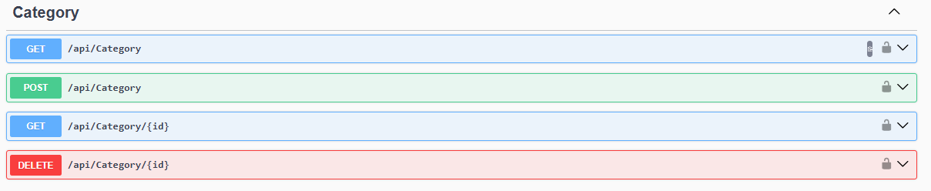
Events & Categories Endpoints

Slide 19
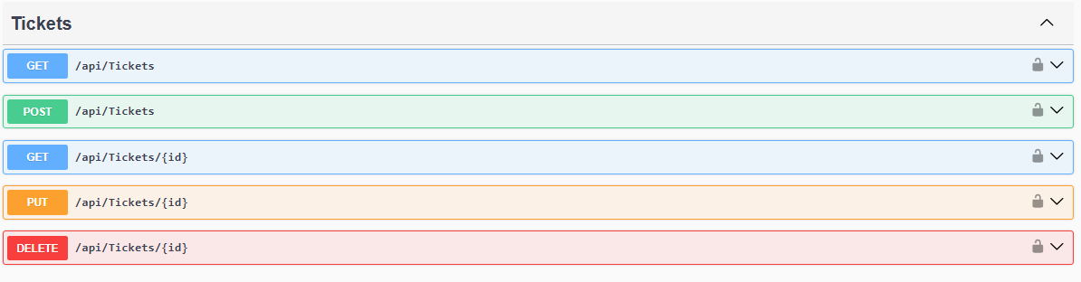
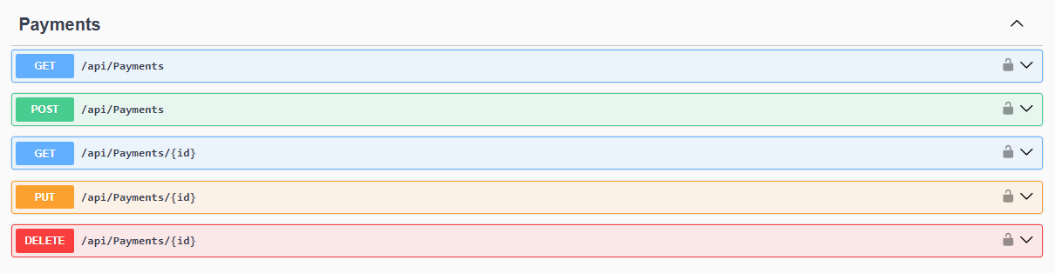
Tickets & Payments Endpoints

Slide 20

THANK YOU

